Slide 1
Why Audio Description and What’s Next
Megan A. Conway, Ph.D.
October, 2021

Slide 2
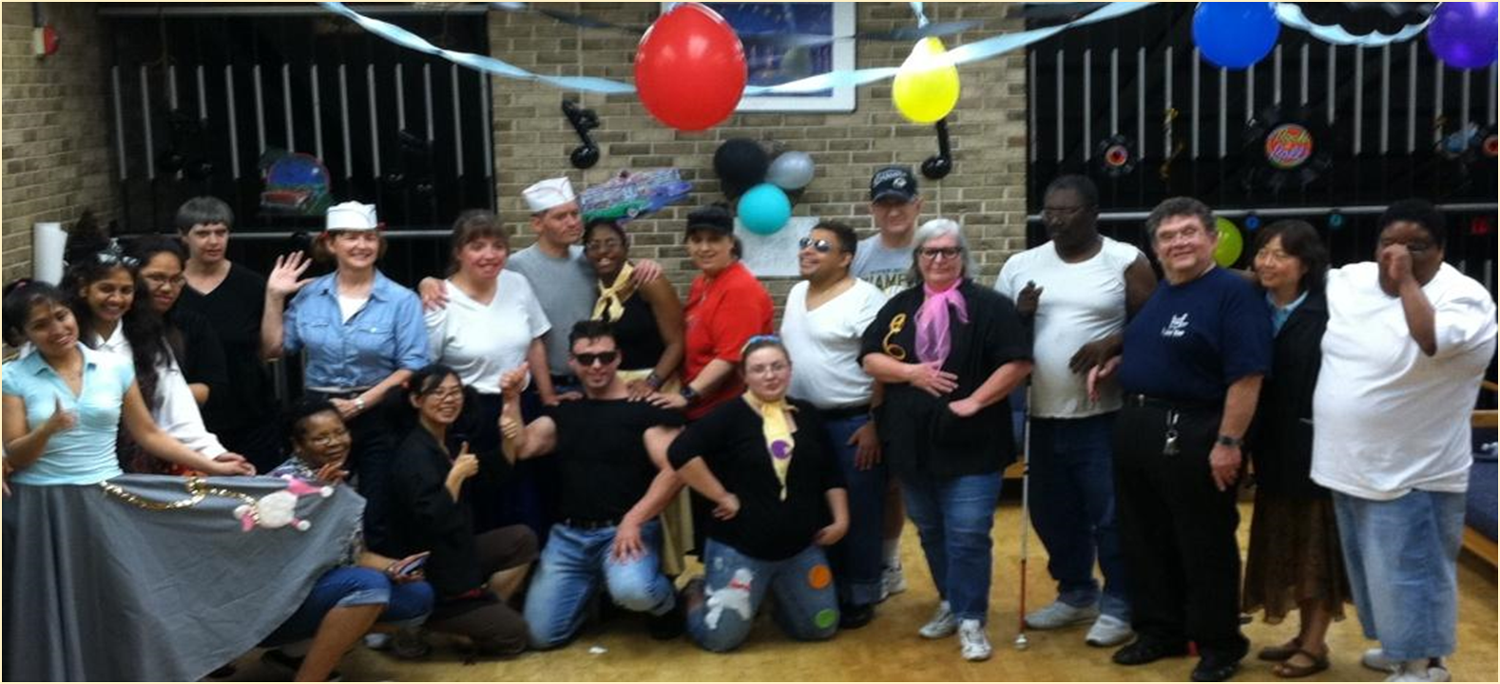
AD and the Community
Blind and DeafBlind people are diverse.
Degree of sensory loss
When acquired
Cultural and communication background

Slide 3
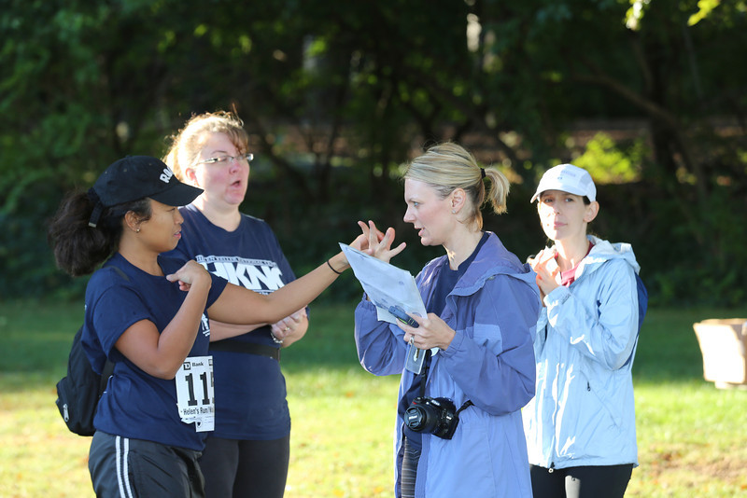
Accessibility and Inclusion
Ensuring equitable access to public resources requires a holistic approach.
Physical access
Sensory access
Cognitive engagement
Need to use a variety of tools.
Tactile, interpreters, captioning, AD, etc.

Slide 4
Current Research
Goal: Use research on audio description, support inclusion, and high quality of life.
Goal: Improve the quality of audio description so that it is useable and impactful.

Slide 5
AD Research Questions
What is the best way to describe portraits and people?
Race
Gender
Age
Disability
How does the context of what we are describing effect how best to describe it?
Brochures
Presentations
Creative Works
Live Action

Slide 6
This has been a presentation by the Helen Keller National Center
We hope this information has been helpful.
This power point is the property of HKNC
Please do not distribute or use for training purposes.
Contact Megan Conway for more information at:
Megan.conway@hknc.org
Notes:
Reasons – We only have permission to use the images and videos in these PPTs for HKNC related trainings/resources. An HKNC ppt should not be utilized as a training tool by a non-HKNC staff member.

